Slide 1
Dr. Anchal Aggarwal
PG Resident
Department of Medicine
DMC& H Ludhiana

Slide 4
BMJ 15th March 2021

Slide 5
POST COVID SYNDROME (as defined by NICE)
Signs and symptoms that develop during or after an infection consistent with covid-19 which continue for more than 12 weeks and are not explained by an alternative diagnosis.
Also known as LONG COVID SYNDROME.

Slide 6
METHODS

Slide 7
STUDY DESIGN
Observational
Retrospective
Matched cohort study of individuals admitted to hospital with covid- 19.
DATA SOURCES
Hospital Episode Statistics admitted Patient Care records for England up to 31 August 2020
General Practice Extraction Service Data for Pandemic Planning and Research (GDPPR) up to 30 September 2020

Slide 8
STUDY POPULATION
CASES- 1 January to 31 August 2020.
With a primary diagnosis of covid-19.
Individuals with covid-19 were excluded if they were not discharged alive by 31 August 2020 or their date of birth or sex was not known.
In sensitivity analyses, they included only patients diagnosed with code U07.1.
CONTROL- individuals in the general population who:
Did not meet the inclusion criteria for covid-19
Had not died before 1 January 2020

Slide 9
OUTCOME VARIABLES
Individuals were followed up from the index date to 30 September 2020 or the date of death (whichever was earlier) for :
All cause mortality
All cause hospital readmission (admission after discharge for patients and admission after the index date for controls)
Respiratory disease
Major adverse cardiovascular event (a composite of heart failure, myocardial infarction, stroke, and arrhythmia)
Diabetes (type 1 or 2)
Chronic kidney disease stages 3-5 (including dialysis and kidney transplant)
Chronic liver disease

Slide 10
MATCHING VARIABLES
Age
Sex
Ethnicity
Deprivation
Smoking status
Body mass index
Previous admission to hospital
Hypertension
Respiratory disease (total, asthma, COPD and others)
Diabetes (Type 1 and Type 2 )
Cancer
Chronic kidney disease stages 3-5
Chronic liver disease
MACE (Heart failure, Stroke, Myocardial infarction, Arrhythmia )

Slide 11
STATISTICAL TECHNIQUES
Distributions for baseline characteristics were compared between individuals with covid-19 and a random 0.5% sample of the general population with χ2 tests and standardised differences in proportions, where a standardised difference or more than 10% indicated a large imbalance between groups.
Patients were matched 1:1 to controls with coarsened exact matching.
Matched pairs were discarded if the control died before the corresponding patient’s index date.
This study computed rates of death, readmission, and multiorgan dysfunction after discharge from hospital per 1000 person years in patients and controls, deriving rate ratios from these rates.

Slide 12
RESULTS

Slide 13
STUDY POPULATION

Slide 14
Mean follow-up :
Covid-19 : 140 ± 50 days (maximum 253 days) for patients.
Controls : 153 ± 33 days (253 days)
At baseline, covid-19 mean age 64.5 ± 19, 54.9% were men.
Covid-19 were more likely to be: male, aged 50 or more, living in a deprived area, a former smoker, and overweight or obese, co-morbid than the general population, higher prevalence of previous admission to hospital and pre-existing conditions
Notes:
(most notably hypertension, major adverse cardiovascular event, respiratory disease, and diabetes).

Slide 15
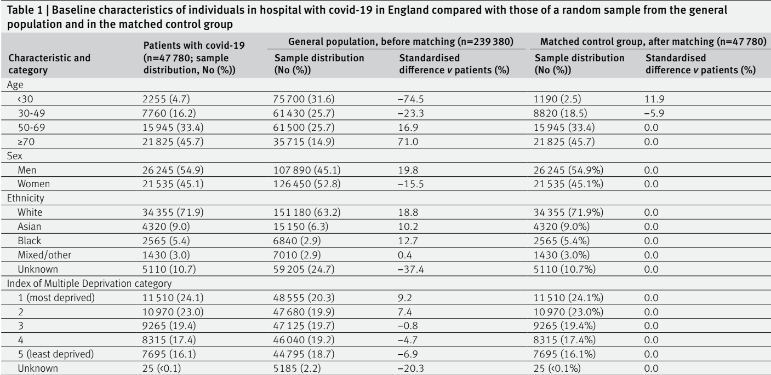
Baseline characteristics : Individuals in hospital with covid-19 General population (matched control group)

Slide 16
Baseline characteristics : Individuals in hospital with covid-19 General population (matched control group)

Slide 17
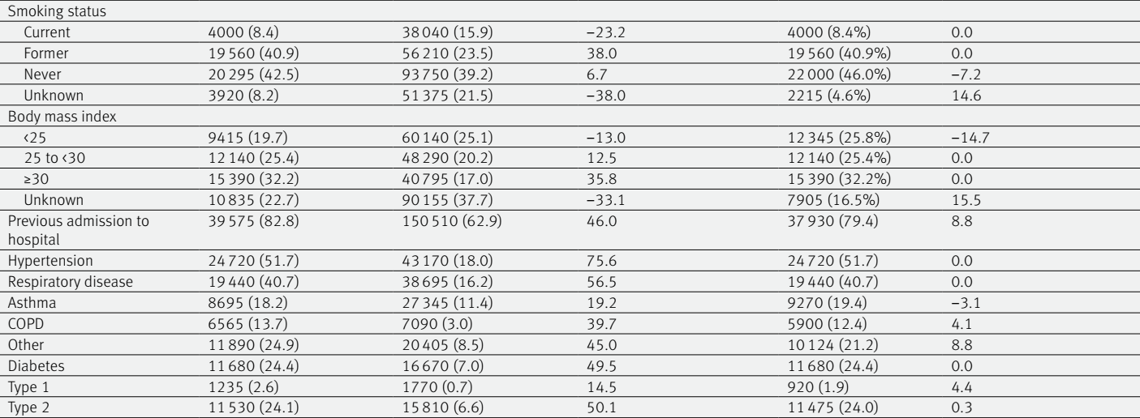
Baseline characteristics : Individuals in hospital with covid-19 General population (matched control group)

Slide 18
Baseline characteristics : Individuals in hospital with covid-19 General population (matched control group)

Slide 19
Counts and rates of death, readmission, and respiratory disease in individuals with covid-19 in England discharged from hospital by 31august 2020 compared with matched controls
7.7 x greater
3.5 x greater
6.0 x greater
27.3 x greater

Slide 20
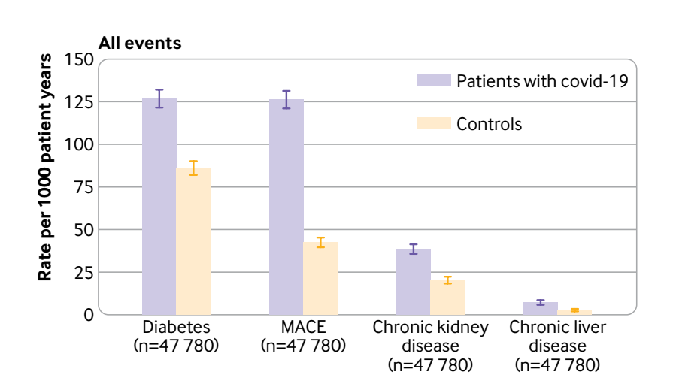
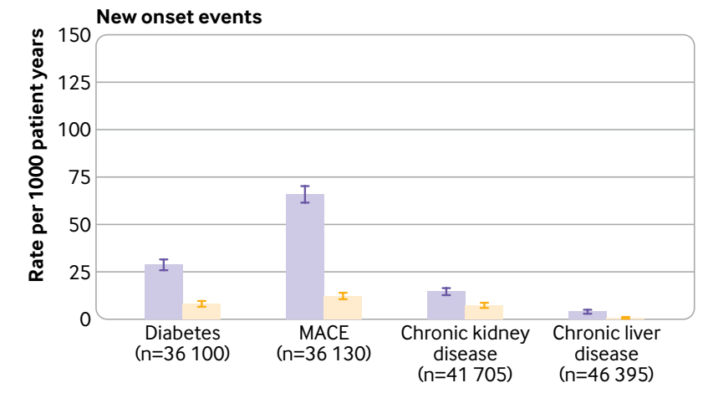
Rates of multiorgan dysfunction : Individuals with covid-19 Matched controls
127
(4.9%)
126
(4.8%)
1.5 x more frequently
3 x more frequently
66
39 (1.5%)
2.8 x more frequently
29
1.9 x more frequently
15
7 (0.3%)
4

Slide 21
Counts and rates of adverse events : Individuals with COVID-19, stratified by ICU versus non-ICU admission

Slide 22
Counts and rates of adverse events : Individuals with COVID-19, stratified by demographic factors

Slide 23
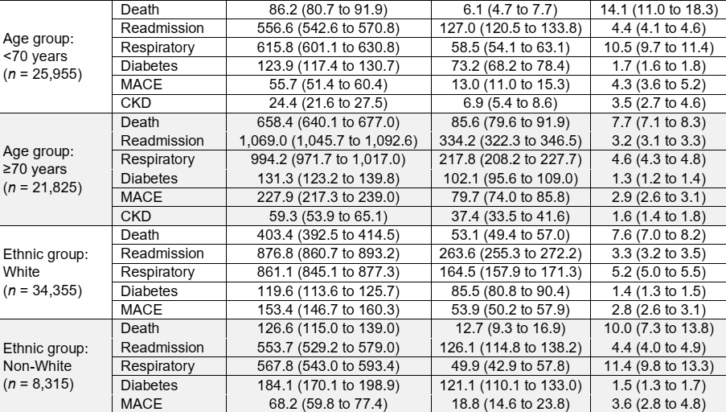

Slide 24
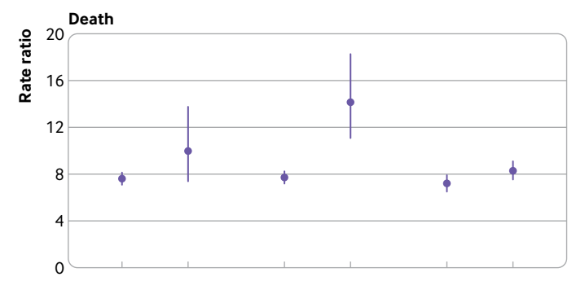
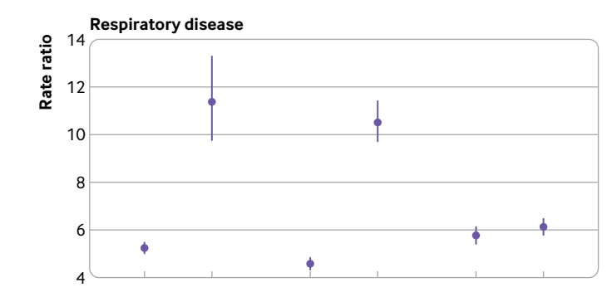
Rate ratios of death and respiratory disease in individuals with covid-19 compared with matched controls
14.1
11.4
10.5
7.7
5.2
4.6
BMJ 2021;372:n693

Slide 25
CONCLUSIONS
Admission to hospital for covid-19 was associated with an increased risk of readmission and death after discharge.
Rates of multiorgan dysfunction after discharge were raised in individuals with covid-19. Diabetes and major adverse cardiovascular event were particularly common.
The absolute risk of death, readmission, and multiorgan dysfunction after discharge was greater for individuals aged 70 or more than for those aged less than 70, and for individuals of white ethnic background than non- white individuals.
Individuals discharged from the intensive care unit after covid-19 experienced greater rates of death and readmission than those not admitted to the intensive care unit.

Slide 26
STRENGTHS
Large sample size
Its completeness
All individuals in England admitted to hospital with covid-19 observed over a follow-up period of several months, matched to general population controls from 10 years of clinical records.

Slide 27
LIMITATIONS
Did not analyse the most common reasons for readmission.
Like all observational studies, residual confounding was possible.
Limited events in the control group meant they could not disaggregate rate ratios stratified by age and ethnicity beyond age less than 70 versus 70 or older and white versus non-white groups, despite likely variations in outcomes within these groups.
Undiagnosed hypertension and diabetes were classified as not having these conditions.

Slide 28
LIMITATIONS
Performing multiple imputation for missing values was not practical because of the size of the study.
They could not access testing data so some individuals with covid-19 who did not require admission to hospital might have been matched in the control group.
Unlikely to fully capture the lived experiences of individuals with post-covid syndrome (such as fatigue, disturbances in taste and smell, and anxiety).

Slide 30
JAMA. 2021 Jan 19;325(3):304-306.
Rates of readmission or death were higher than pneumonia or heart failure during the first 10 days after discharge following COVID-19 hospitalization, suggesting a period of heightened risk of clinical deterioration.

Slide 31
In a young, low-risk population with ongoing symptoms, almost 70% of individuals have impairment in one or more organs four months after initial symptoms of SARS-CoV-2 infection.

Slide 32
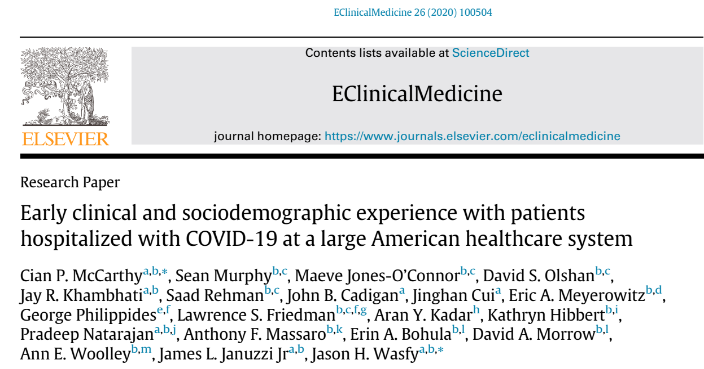
Although intensive care utilization was frequent (42%), the majority of hospitalized patients were discharged alive (86%). However, survivors of COVID-19 have substantial new comorbidities and needs after discharge.

Slide 33
Among people admitted to hospital, compared with seasonal influenza, covid-19 was associated with increased risk of extrapulmonary organ dysfunction, death, and increased health resource use.

Slide 34
Pulmonary lesions were found in patients with covid-19 admitted to hospital in Wuhan, China, after a short follow-up of three weeks after discharge.

Slide 35
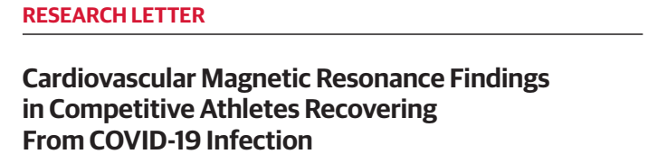
JAMA. 2021;06(1):116-118
Of 26 competitive athletes,
4 (15%) had CMR findings suggestive of myocarditis
8 additional athletes (30.8%) exhibited LGE without T2 elevation suggestive of prior myocardial injury.
COVID-19–related myocardial injury in competitive athletes and sports participation remains unclear.

Slide 36
Increased glucose levels have been associated with the development of ARDS and worsening of SARS- CoV- 2 illness requiring intubation and mechanical ventilation.
Central hypothyroidism and central hypocortisolism seem to occur commonly in patients infected with coronavirus.
These changes are usually transient and occur during the illness or after recovery.

Slide 37
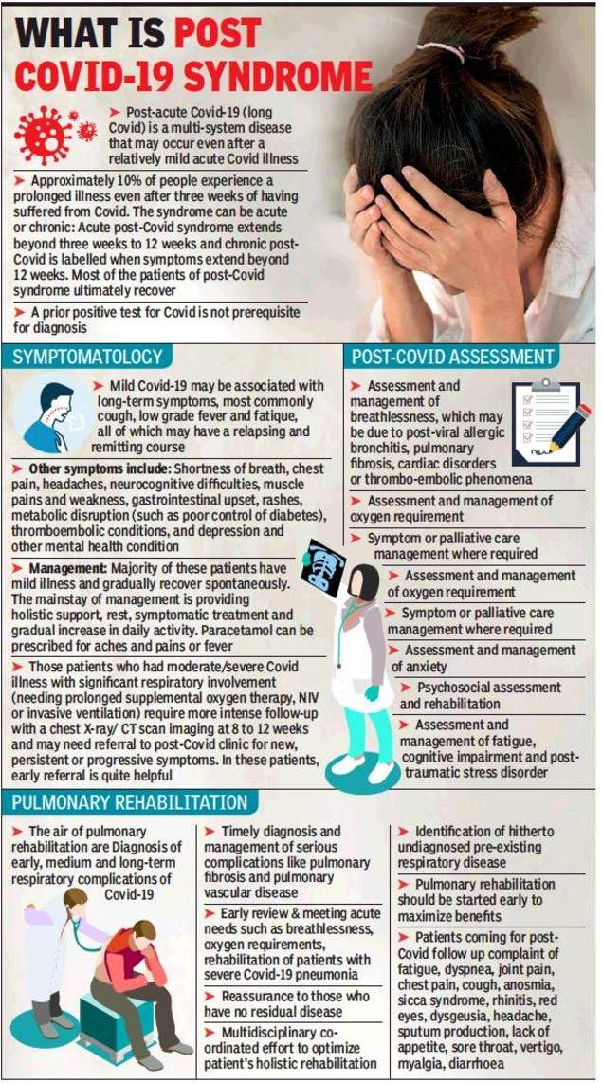
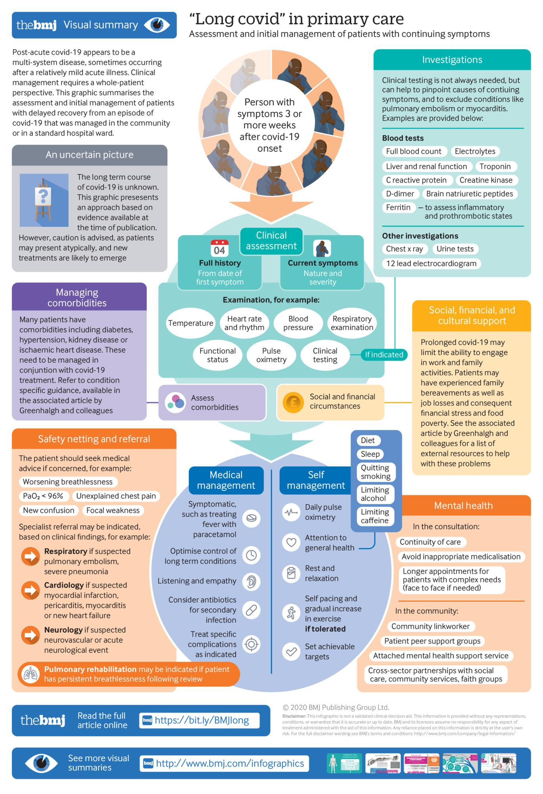

Slide 39
THANK YOU

